Slide 1
FINANCIAL MANAGEMENT
ASSIGNMENT
GROUP-8

Slide 2
GROUP MEMBERS
NAME | ID
RAJKUMAR SA | 2022A8PS0851H
TANISHQ KURADE | 2022A7PS0208H
VAISHNAVI CHANNUR | 2022A2PS1428H
ARUNA SINDHURA KANAKALA | 2022A2PS1840H
SHRI DARSHAN GUTURU | 2022A1PS1694H

Slide 3
OBJECTIVE
Name of the Company: Bharat Electronics Ltd
● Calculation of Cost of Equity Capital (RS ):
a. Using Top Down Approach
b. Using Bottom Up Approach
● Calculation of Cost of Debt
● Calculation of Cost of Capital

Slide 4
ACKNOWLEDGEMENT
We would like to sincerely thank Dr. Sravani Bharandev and Dr. Nivedita Sinha for allowing us to work under their supervision on this assignment and for giving their important time to provide us the necessary advice when needed. We are grateful to them for giving us this amazing chance to put our course knowledge to use on actual data and get practical experience. We are grateful for their assistance and direction during the course and with this task.

Slide 5
INDUSTRY OVERVIEW
The electronics industry is the economic sector that produces electronic devices. It emerged in the 20th century and is today one of the largest global industries. Contemporary society uses a vast array of electronic devices that are built in factories operated by the industry, which are almost always partially automated. The eCommerce Electronics market is a sector of online retailing that focuses on selling electronic devices, gadgets, and accessories through digital channels. The purpose of eCommerce Electronics is to provide consumers with a convenient and accessible way to purchase a wide range of products, including smartphones, laptops, cameras, and smart home devices.
Revenue in the Electronic Market is projected to reach US$11.08bn in 2024.Revenue is expected to show an annual growth rate (CAGR 2024-2029) of 8.91%, resulting in a projected market volume of US$16.98bn by 2029.In the Electronic Market, the number of users is expected to amount to 288.5m users by 2029.

Slide 6
SHAREHOLDING
The shareholding pattern reflects the distribution of ownership among different categories of shareholders, including promoters, institutional investors, and the public. This pattern plays a vital role in shaping the company's corporate governance practices, strategic decisions, and overall performance in the electronics industry. As the company continues to evolve and grow, monitoring changes in its shareholding pattern remains essential for investors, regulators, and other stakeholders.
The shareholding pattern is subject to fluctuations over time due to various factors such as buying and selling of shares by investors, corporate actions like bonus issues or rights offerings. A transparent and well-balanced shareholding pattern is very crucial for ensuring effective corporate governance.

Slide 7

Bharat Electronics LTD

Slide 8
Bharat Electronics Limited (BEL)
Bharat Electronics Limited (BEL) is an Indian public sector aerospace and defence electronics company. It primarily manufactures advanced electronic products for ground and aerospace applications. BEL is one of sixteen PSUs under the administration of Ministry of Defence of India. It has been granted Navratna status by the Government of India.
Bharat Electronics Limited was founded in Bangalore, Karnataka, India in 1954. Starting with the manufacturing of a few communication equipment in 1956, BEL started manufacturing receiving valves in 1961, germanium semiconductors in 1962, and radio transmitters for AIR in 1964 with help from the Soviet Union. A memorandum of understanding was signed on September 30, 2024, between Bharat Electronics and the Space Applications Centre, pertaining to collaboration, indigenization, and infrastructure development for the production of space-grade Travelling Wave Tube Amplifiers.

Slide 9
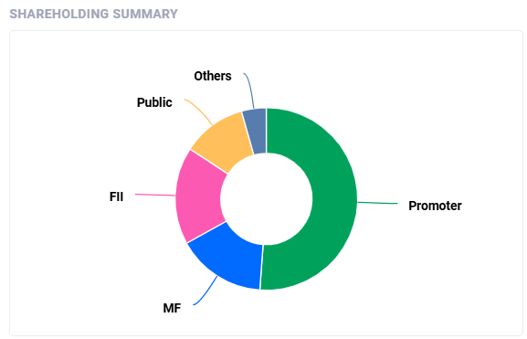
SHAREHOLDING PATTERN

Slide 10
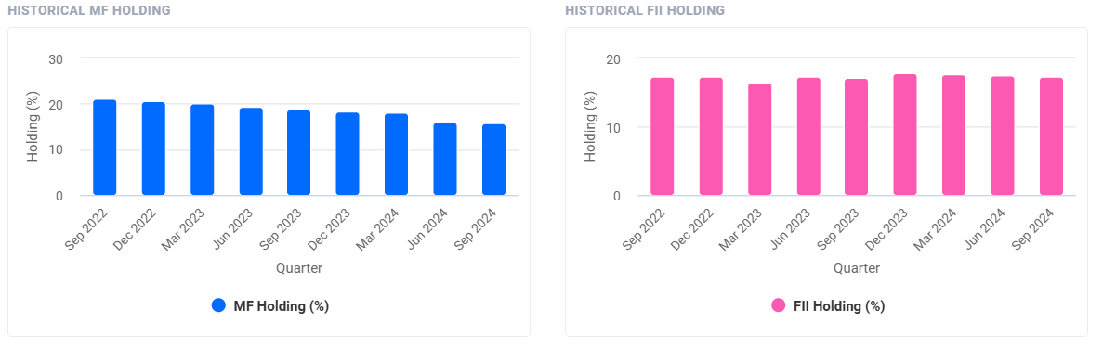
SHAREHOLDING PATTERN
Promoters holding remains unchanged at 51.14% in Sep 2024 qtr
Number of FII/FPI investors increased from 1405 to 1459 in Sep 2024 qtr
FII/FPI have decreased holdings from 17.43% to 17.27% in Sep 2024 qtr
Mutual Funds have decreased holdings from 16.08% to 15.81% in Sep 2024 qtr
Number of MF schemes increased from 344 to 369 in Sep 2024 qt
Institutional Investors have decreased holdings from 38.05% to 37.49% in Sep 2024 qtr

Slide 11
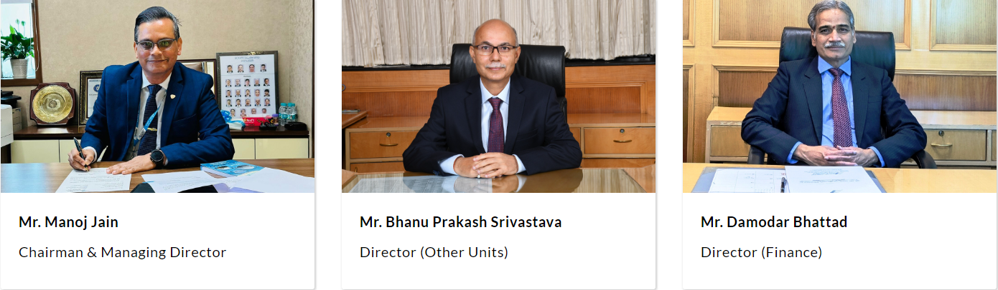
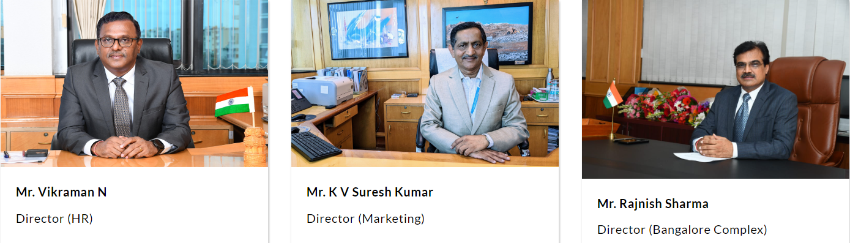
BOARD OF DIRECTORS

Slide 12
Company Reference
Sector | Aerospace and Defense Electronics
Industry | Electronics
Market Cap | ₹2,19,293 Cr
Category | Large Cap

Slide 13





CHOSEN COMPARABLE COMPANIES

Slide 14
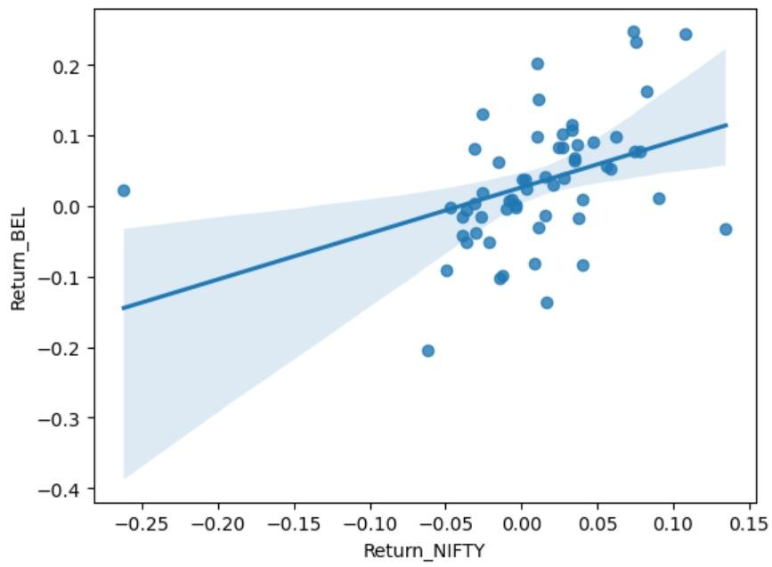
VARIOUS OBSERVATIONS FROM THE CODE
REGRESSION FOR COMPANY RETURNS VS NIFTY RETURNS

Slide 15
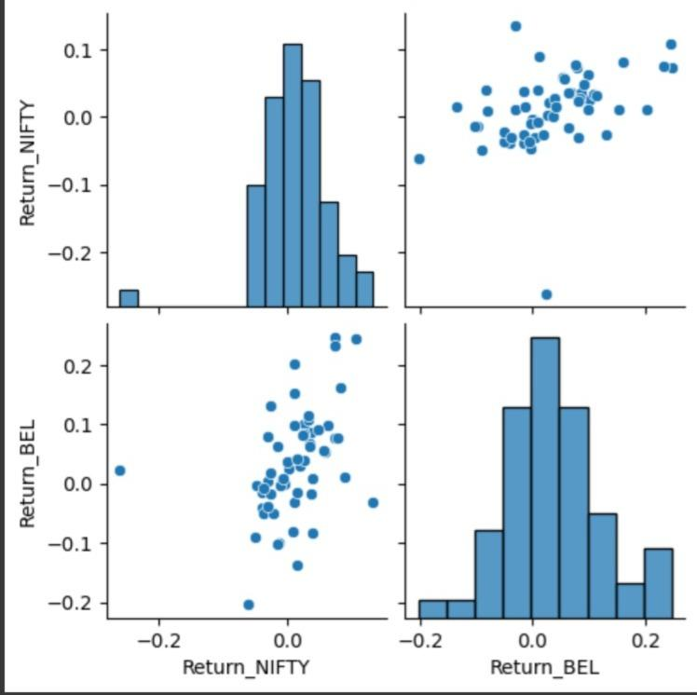
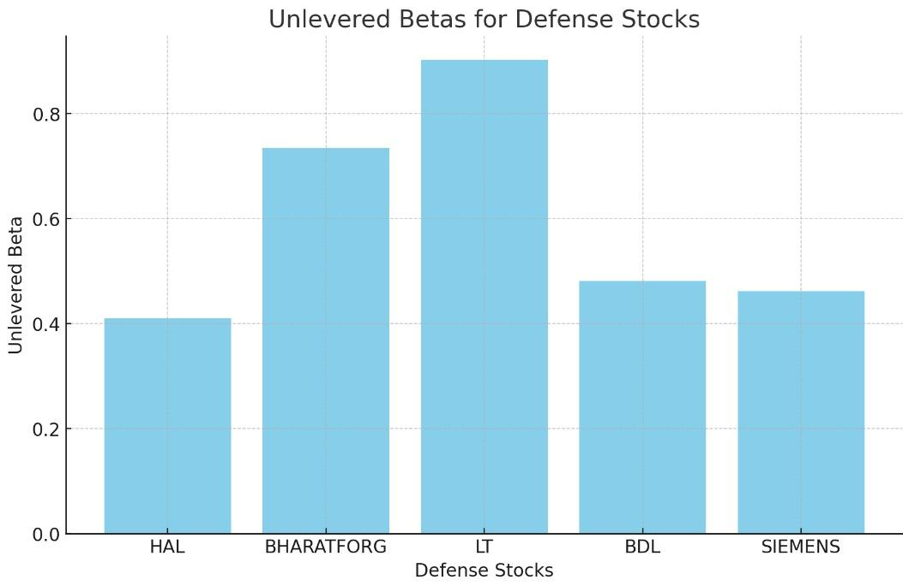
COMPARING WITH Rm REGRESSION

Slide 16
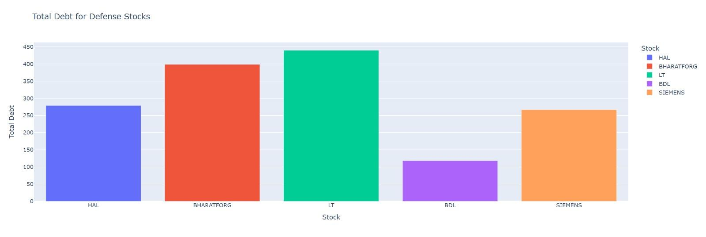
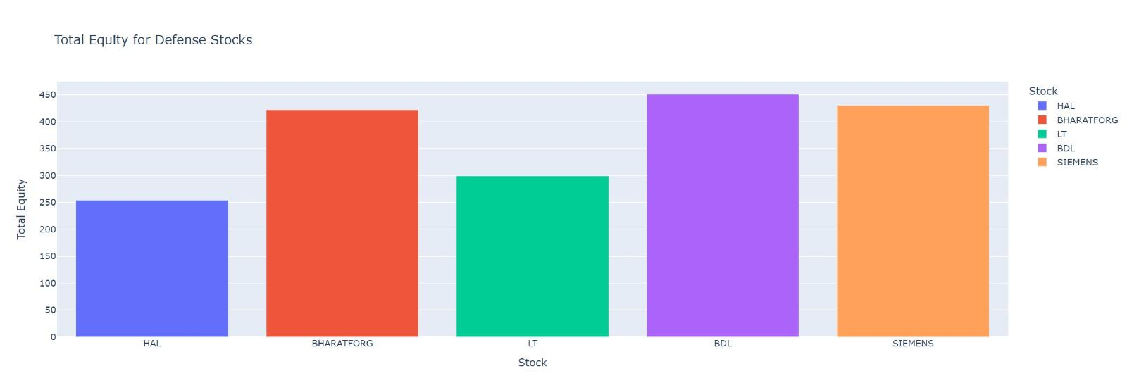
VARIOUS OBSERVATIONS FROM THE CODE
Total Debt
Total Equity

Slide 17
BHARAT FORGE

Slide 18
Bharat Forge
Bharat Forge Limited is an Indian multinational company involved in forging, automotives, energy, construction and mining, railways, marine, aerospace and defence industries.
The company was founded by Nilkanthrao A. Kalyani on 19 June 1961. Headquartered in Pune, Maharashtra, it is the flagship company of the Kalyani Group. Bharat Forge's Special Economic Zone (SEZ) named Khed City is spread over an area of 1,000 hectares (4200 acres) in Khed taluka, and is the largest SEZ in Pune district. It was the first company promoted by the Kalyani Group and remains the Group's flagship company. The current chairman of the company is the founder's son, Baba Kalyani. Currently Bharat Forge is the "world’s largest single location forging facility consisting of fully automated forging press lines and state-of-the-art machining facility.

Slide 19
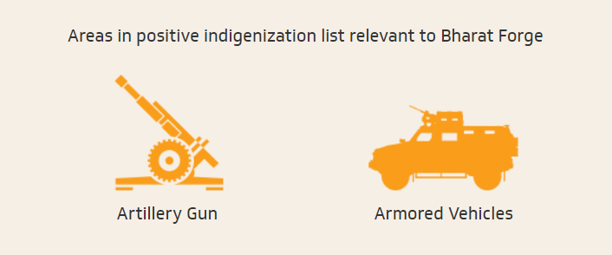
For over a decade, Bharat Forge has established multiple capabilities in Defence manufacturing catering to the Indian and Global Armed Forces. The significant stride taken by the Government in FY 2022 towards self-reliance with the preparation of positive indigenization list has opened huge opportunities for Indian players.

Slide 20
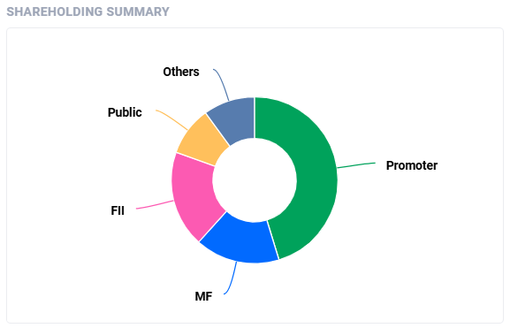
SHAREHOLDING PATTERN

Slide 21
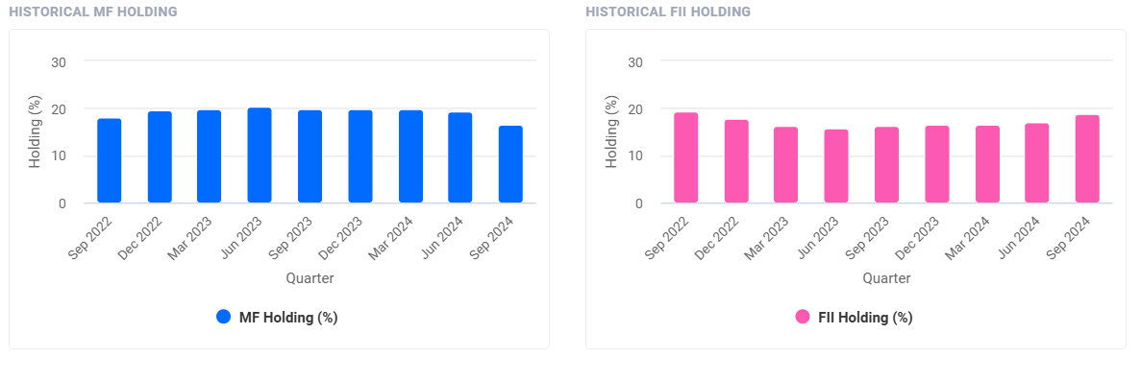
SHAREHOLDING PATTERN
Promoters holding remains unchanged at 45.25% in Sep 2024 qtr
FII/FPI have increased holdings from 17.04% to 18.72% in Sep 2024 qtr.
Number of FII/FPI investors increased from 588 to 610 in Sep 2024 qtr.
Mutual Funds have decreased holdings from 19.35% to 16.46% in Sep 2024 qtr
Number of MF schemes increased from 31 to 32 in Sep 2024 qtr.
Institutional Investors have increased holdings from 45.18% to 45.20% in Sep 2024 qtr.

Slide 22
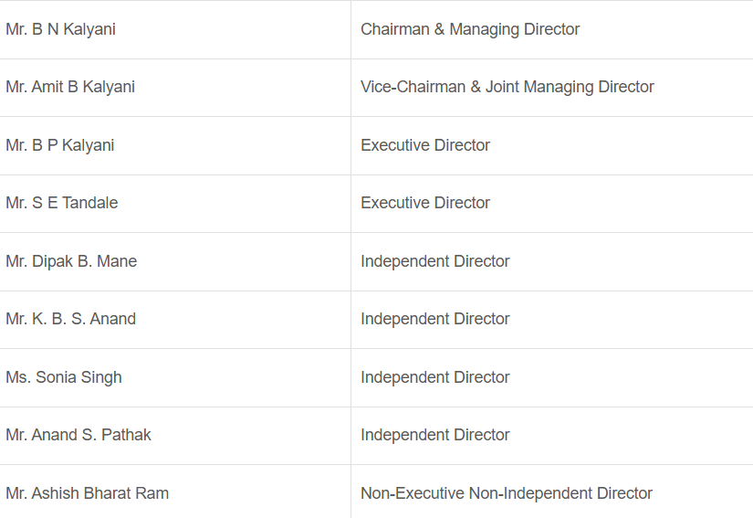
BOARD OF DIRECTORS

Slide 23
Company Reference
Sector | Aerospace and Defense
Industry | Electronics
Market Cap | ₹68,442 Cr
Category | Large Cap
 | .

Slide 24
LARSEN & TOUBRO

Slide 25
Larsen & Toubro
Larsen & Toubro is an Indian multinational engaged in EPC Projects, Hi-Tech Manufacturing and Services. It operates in over 50 countries worldwide. A strong, customer-focused approach and the constant quest for top-class quality have enabled L&T to attain and sustain leadership in its major lines of business for over eight decades. We are engaged in core, high impact sectors of the economy and our integrated capabilities span the entire spectrum of ‘design to delivery’. Every aspect of L&T's businesses is characterised by professionalism and high standards of corporate governance. Sustainability is embedded into our long-term strategy for growth. The Company’s manufacturing footprint extends across eight countries in addition to India. L&T has several international offices and a supply chain that extends around the globe.
Henning Holck-Larsen and Søren Kristian Toubro were in India to represent the interests of the Danish dairy equipment manufacturer FLSmidth when they founded L&T through an oral agreement in 1938. The company was legally incorporated in 1946

Slide 26
Larsen & Toubro (L&T) is a private sector company in India that has a long-standing partnership with the Indian Armed Forces and the Defence Research and Development Organisation (DRDO). L&T is involved in the design, development, and production of a range of military equipment and systems, including:
Radar systems: L&T has developed radar deployment systems and high-power radars
Weapon systems: L&T has supplied Close-In Weapon Systems (CIWS) to the Indian Air Force (IAF)
Missile systems: L&T has developed supersonic cruise missiles and ship-borne Brahmos systems
Submarines: L&T was involved in the design and construction of India's first nuclear-powered submarine
Communications systems: L&T has developed ruggedized tactical communications systems
Engineering systems: L&T has developed engineering systems for the military

Slide 27
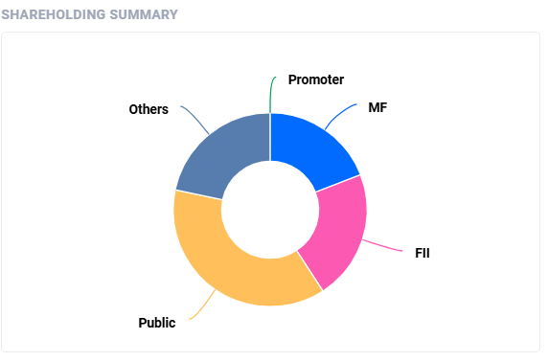
SHAREHOLDING PATTERN

Slide 28
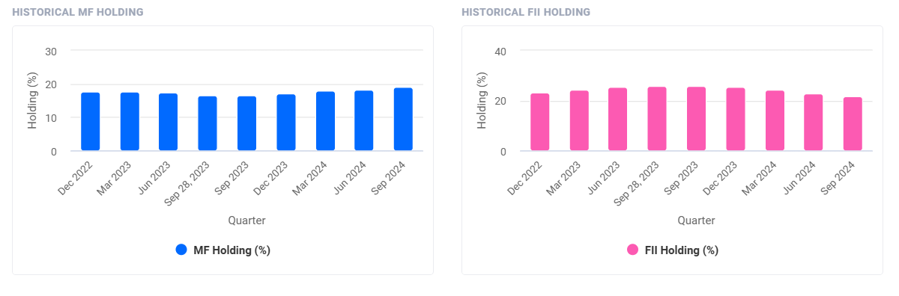
SHAREHOLDING PATTERN
FII/FPI have decreased holdings from 22.85% to 21.72% in Sep 2024 qtr
Number of FII/FPI investors decreased from 1287 to 1248 in Sep 2024 qtr
Mutual Funds have increased holdings from 18.13% to 19.14% in Sep 2024 qtr.
Number of MF schemes decreased from 57 to 56 in Sep 2024 qtr
Institutional Investors have increased holdings from 62.11% to 62.53% in Sep 2024 qtr.

Slide 29
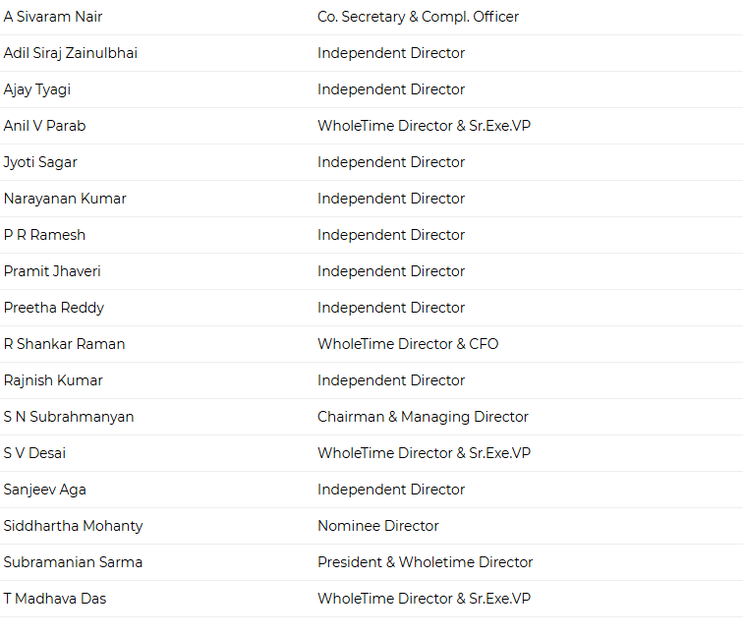
BOARD OF DIRECTORS

Slide 30
Company Reference
Sector | Military and Manufacturing
Industry | Electronics
Market Cap | ₹4,97,790 Cr
Category | Large Cap

Slide 31
SIEMENS

Slide 32
Siemens
Siemens is a German multinational technology conglomerate. It is focused on industrial automation, distributed energy resources, rail transport and health technology. Siemens is the largest industrial manufacturing company in Europe, and holds the position of global market leader in industrial automation and industrial software. As of 2023, the principal divisions of Siemens are Digital Industries, Smart Infrastructure, Mobility, and Financial Services, with Siemens Mobility operating as an independent entity. Major business divisions that were once part of Siemens before being spun off include semiconductor manufacturer Infineon Technologies (1999), Siemens Mobile (2005), Gigaset Communications (2008), the photonics business Osram (2013), Siemens Healthineers (2017), and Siemens Energy (2020).
The company built the first long-distance telegraph line in Europe: 500 km from Berlin to Frankfurt am Main. In 1850, the founder's younger brother, Carl Wilhelm Siemens, later Sir William Siemens, started to represent the company in London. The London agency became a branch office in 1858.

Slide 33
Siemens is engaged in India’s defense and homeland security sector, primarily through digital infrastructure and security partnerships. Key collaborations include projects with Reliance Security Solutions, where Siemens provides intelligent security systems designed for wide-area surveillance and critical infrastructure protection. This partnership leverages advanced video surveillance, command, and control systems to support Indian security agencies in countering modern security threats and managing large-scale public areas, highways, and sensitive locations.
Siemens is also a significant player in Industry 4.0 applications, which impact various defense-related manufacturing sectors. The company operates MindSphere Application Centers across India, focusing on IoT solutions that enhance productivity, data analysis, and automation in defense manufacturing and infrastructure. This digitization support aligns with India’s defense indigenization goals, allowing Siemens to contribute indirectly to military technology advancements by streamlining production capabilities in key sectors, including aerospace and heavy machinery.

Slide 34
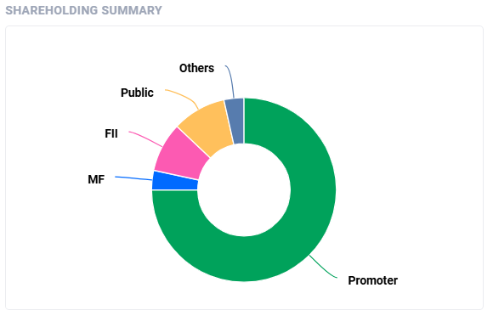
SHAREHOLDING PATTERN

Slide 35
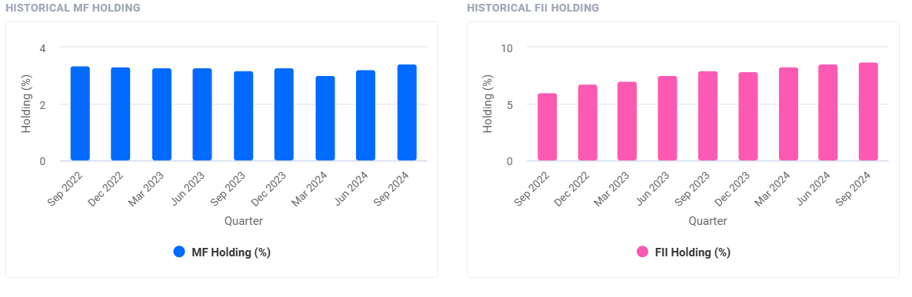
SHAREHOLDING PATTERN
Promoters pledge remained unchanged at 6.67% of holdings in Sep 2024 qtr.
Promoters holding remains unchanged at 75.00% in Sep 2024 qtr
FII/FPI have increased holdings from 8.59% to 8.69% in Sep 2024 qtr.
Number of FII/FPI investors increased from 867 to 870 in Sep 2024 qtr.
Mutual Funds have increased holdings from 3.23% to 3.41% in Sep 2024 qtr.
Number of MF schemes remains unchanged at 32 in Sep 2024 qtr
Institutional Investors have decreased holdings from 15.62% to 15.59% in Sep 2024 qtr

Slide 36
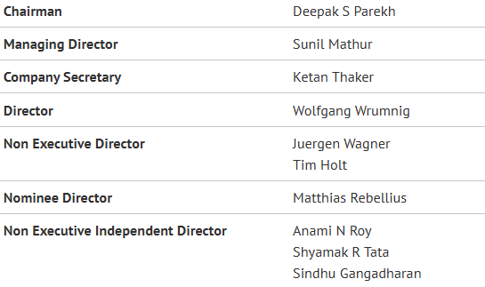
BOARD OF DIRECTORS

Slide 37
Company Reference
Sector | Technology
Industry | Technology
Market Cap | ₹2,51,896 Cr
Category | Large Cap

Slide 38
BHARAT DYNAMICS LIMITED

Slide 39
Bharat Dynamics Limited
Bharat Dynamics Limited (BDL) is one of India's manufacturers of munitions and missile systems. It was founded in 1970 in Hyderabad, India. BDL was established to be a manufacturing base for guided weapon systems and begun with a pool of engineers drawn from Indian Ordnance Factories, DRDO and aerospace industries, it began by producing a first generation anti-tank guided missile - the French SS11B1. While fulfilling its basic role as a weapons system manufacturer, BDL has built up in-house R&D capabilities primarily focusing on design and engineering activities.
India began to develop indigenous missiles through the Integrated Guided Missile Development Programme (IGMDP), which gave BDL an opportunity to be closely involved with the programme wherein it was identified as the prime production agency. This opened up a plethora of opportunities to assimilate advanced manufacturing and programme management technologies and skills.Responding to the concurrent engineering approaches adopted by the Defence Research and Development Organisation (DRDO) in the Integrated Guided Missile Development Programme (IGMDP), BDL was seen as a reliable and trustworthy partner, and resulted in the induction of India's first state-of-the-art surface-to-surface missile Prithvi.

Slide 40
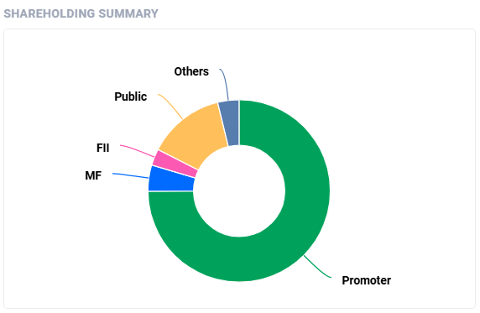
SHAREHOLDING PATTERN

Slide 41
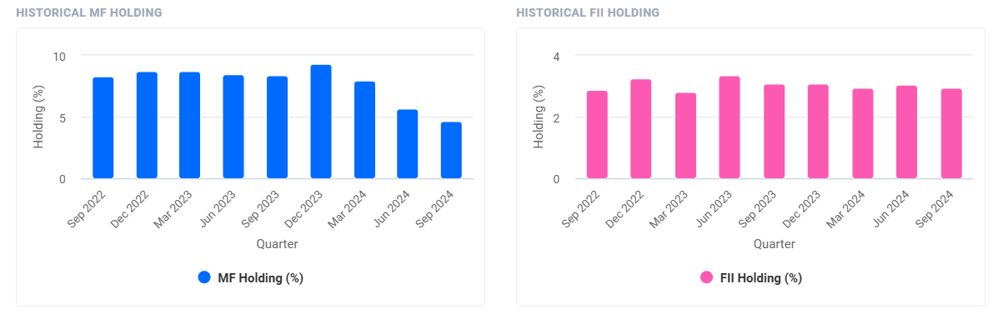
SHAREHOLDING PATTERN
Promoters holding remains unchanged at 74.93% in Sep 2024 qtr
FII/FPI have decreased holdings from 3.06% to 2.94% in Sep 2024 qtr
Number of FII/FPI investors increased from 157 to 352 in Sep 2024 qtr.
Mutual Funds have decreased holdings from 5.67% to 4.64% in Sep 2024 qtr
Number of MF schemes decreased from 24 to 21 in Sep 2024 qtr
Institutional Investors have decreased holdings from 12.58% to 11.40% in Sep 2024 qtr

Slide 42
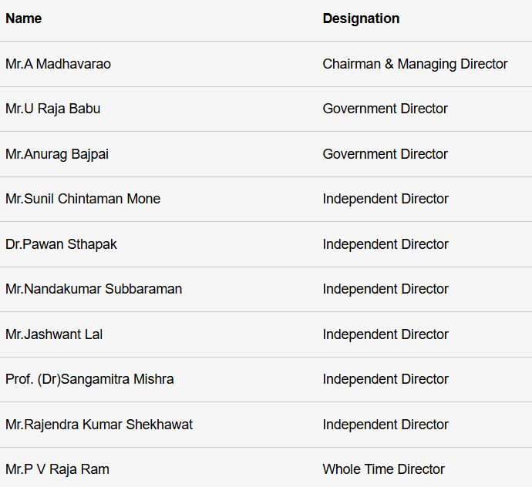
BOARD OF DIRECTORS

Slide 43
Company Reference
Sector | Engineering
Industry | Aerospace and Defense
Market Cap | ₹ 39,797 Cr
Category | Mid Cap

Slide 44
Hindustan Aeronautics Limited

Slide 45
Hindustan Aeronautics Limited
Hindustan Aeronautics Limited (HAL) is an Indian public sector aerospace and defence company, headquartered in Bangalore (Bengaluru). Established on 23 December 1940, HAL is one of the oldest and largest aerospace and defence manufacturers in the world. HAL began aircraft manufacturing as early as 1942 with licensed production of Harlow PC-5, Curtiss P-36 Hawk and Vultee A-31 Vengeance for the Indian Air Force. HAL currently has 11 dedicated Research and development (R&D) centres and 21 manufacturing divisions under 4 production units spread across India. HAL is managed by a board of directors appointed by the President of India through the Ministry of Defence, Government of India. In 2024, the company was given Maharatna status. HAL is currently involved in the designing and manufacturing of fighter jets, helicopters, jet engine and marine gas turbine engine, avionics, hardware development, spares supply, overhauling and upgrading of Indian military aircraft.
HAL was established as Hindustan Aircraft Limited in Bangalore on 23 December 1940 by Walchand Hirachand in association with Krishna Raja Wadiyar IV of Kingdom of Mysore.[10] Walchand Hirachand became chairman of the company. The company's office was opened at a bungalow called "Eventide" on Domlur Road

Slide 46
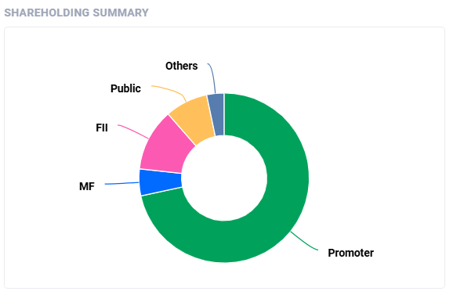
SHAREHOLDING PATTERN

Slide 47
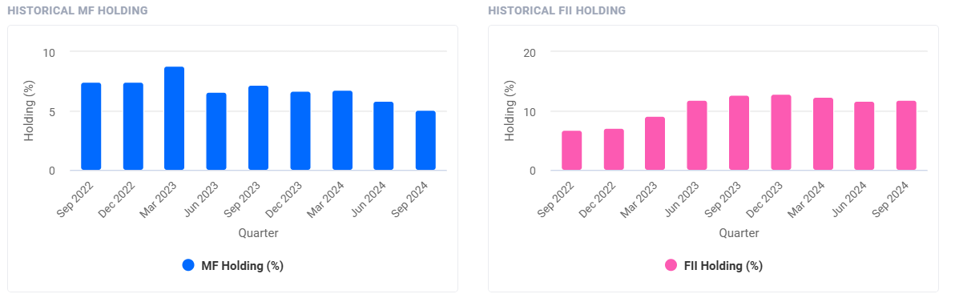
SHAREHOLDING PATTERN
Promoters holding remains unchanged at 71.64% in Sep 2024 qtr
FII/FPI have increased holdings from 11.68% to 11.85% in Sep 2024 qtr.
Number of FII/FPI investors increased from 846 to 878 in Sep 2024 qtr.
Mutual Funds have decreased holdings from 5.84% to 5.10% in Sep 2024 qtr
Number of MF schemes increased from 37 to 38 in Sep 2024 qtr.
Institutional Investors have decreased holdings from 20.49% to 20.22% in Sep 2024 qtr

Slide 48
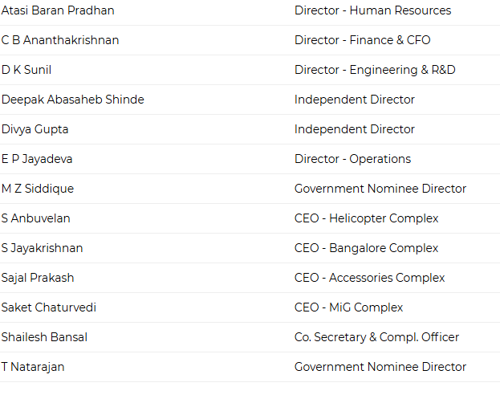
BOARD OF DIRECTORS

Slide 49
Company Reference
Sector | Aerospace and Defense
Industry | Aerospace and Defense
Market Cap | ₹ 2,93,469 Cr
Category | Large Cap

Slide 50
Cost of Equity capital using
Top-Down Approach

Slide 51
TOP-DOWN APPROACH
The "top-down approach" is a method used in financial and investment analysis to estimate a company's cost of debt. Unlike the bottom-up approach, which examines individual debt instruments, the top-down approach calculates the cost of debt using market data and industry benchmarks.
This method focuses on using market comparisons to determine the cost of debt, which can be particularly useful when specific details about a company’s debt instruments are not readily available or when there's a need to compare the company’s cost of debt to others in the same industry. The top-down approach offers a quicker and simpler means to assess a company’s cost of debt by leveraging general market data and industry standards.

Slide 52
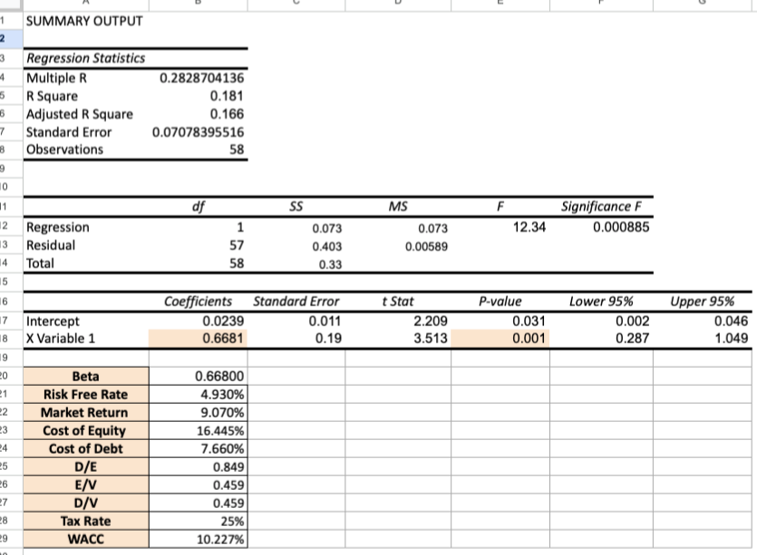
TOP-DOWN APPROACH
We calculated the cost of equity capital using CAPM Model.
The statistical significance
of beta is that if the market changes by 1%, the
investment's value changes by only 0.66%.

Slide 53
Cost of Equity Capital using Bottom-Up Approach

Slide 54
BOTTOM- UP APPROACH
The "bottom-up approach" is a method used in finance and investment analysis to determine a company's cost of debt. In contrast to the traditional weighted average cost of capital (WACC) approach, which calculates the overall cost of debt based on a company’s entire capital structure, the bottom-up approach focuses on the individual debt instruments.
This approach enables a more detailed analysis of a company's cost of debt by considering the specific terms and interest rates of each debt instrument. It is especially useful for companies with complex capital structures or those that employ a variety of debt instruments with differing terms and rates.

Slide 55
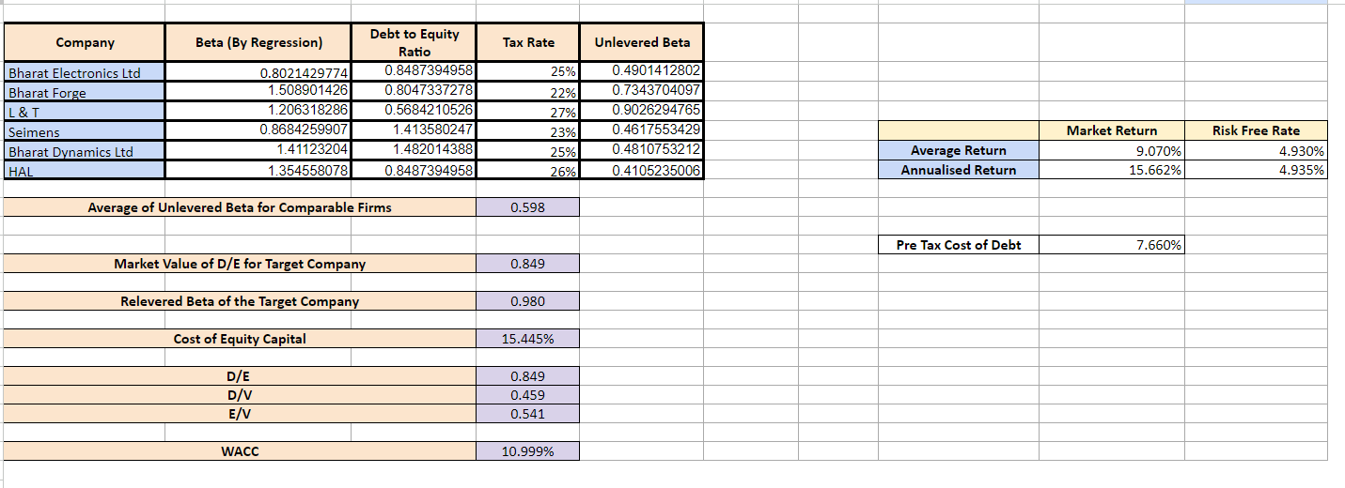
BOTTOM- UP APPROACH
We calculated the beta of comparable companies from the regression. Using D/E ratios,we calculated the unlevered beta.
We found the average of unlevered beta that comes out to be 0.598.
Now we got the market value of D/E for Bharat Electronics Limited and relevered the beta for the same.

Slide 56
Cost of Debt

Slide 57
COST OF DEBT
The cost of debt is the effective rate that a company pays on its borrowed funds. It represents the interest expense a company incurs on its debt.
The formula to calculate the cost of debt typically involves finding the weighted average of the interest rates the company is paying on its various forms of debt. This formula is as follows:
Cost of Debt= Total Interest Expense/Total Debt
Cost of Debt= Total Debt/Total Interest Expense
Where:
Total Interest Expense is the total amount of interest paid by the company over a specific period.
Total Debt is the total amount of debt the company has, including both short-term and long-term debt.

Slide 58
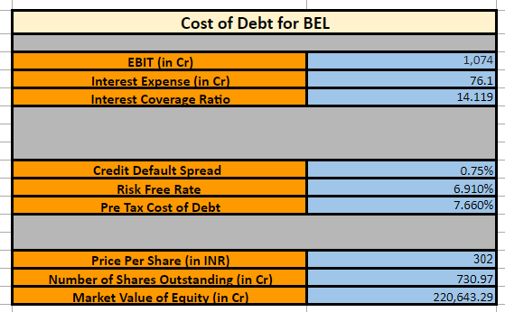
COST OF DEBT
We calculated the Interest Coverage Ratio (EBIT/Interest) and that comes out to be 14.119 . Using this we found the credit default spread which is 0.75%. (Large Cap)
We used the Rf and default spread to find the cost of debt

Slide 59
Cost of Capital of Firm

Slide 60
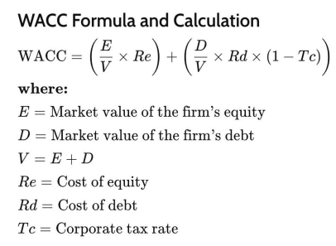
COST OF CAPITAL OF FIRM
A firm's cost of capital is the weighted average of the costs associated with the different sources of capital it uses to fund its operations. These sources usually comprise equity (such as common stock) and debt (like bonds and loans). The cost of capital is a vital concept in finance because it reflects the minimum return a company must generate on its investments to meet the expectations of its investors and creditors.

Slide 61
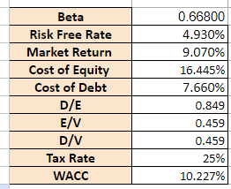
COST OF CAPITAL OF FIRM
WACC= 10.227%

Slide 62
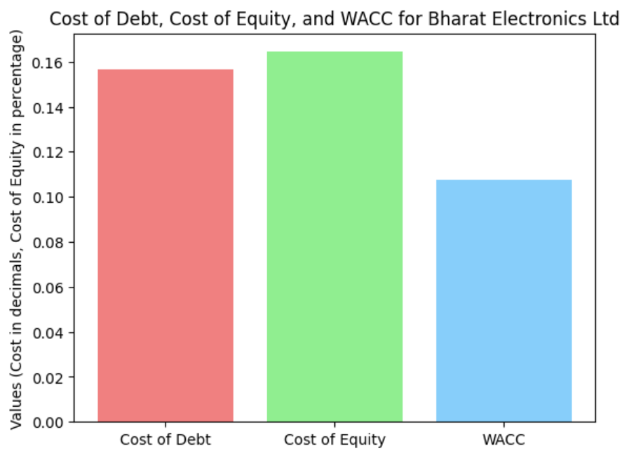
OBSERVATIONS FROM THE CODE

Slide 63
REFERENCES

Slide 64
REFERENCES
https://www.bharatforge.com
https://economictimes.indiatimes.com/bharat-forge-ltd/infocompanymanagement/companyid-20243.cms
https://www.larsentoubro.com
https://economictimes.indiatimes.com/larsen-toubro-ltd/infocompanymanagement/companyid-11906.cms
https://www.siemens.com
https://economictimes.indiatimes.com/siemens-ltd/infocompanymanagement/companyid-13573.cms https://www.bombaydyeing.com
https://economictimes.indiatimes.com/bombay-dyeing-manufacturing-co-ltd/infocompanymanagement/companyid-14184.cms
https://hal-india.co.in
https://economictimes.indiatimes.com/hindustan-aeronautics-ltd/infocompanymanagement/companyid-34718.cms

Slide 65
THANK YOU

